Slide 1
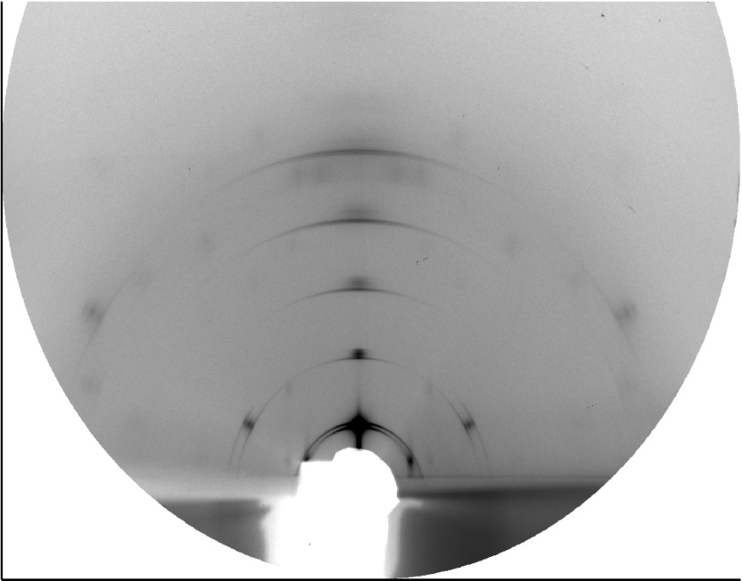
out-of-plane
χ = 90°
detector
z
y
χ
x
α_{f}
Q
in-plane
χ = 0°
Q_{z}
2θ_{f}
Q_{xy}
L_{SD}
α_{i}
sample

Slide 2
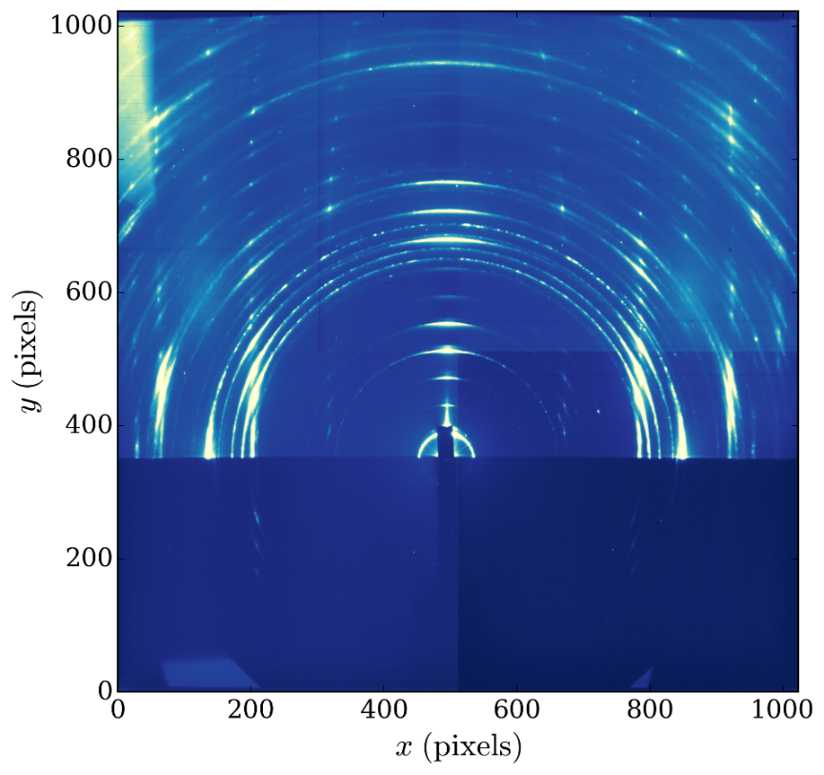
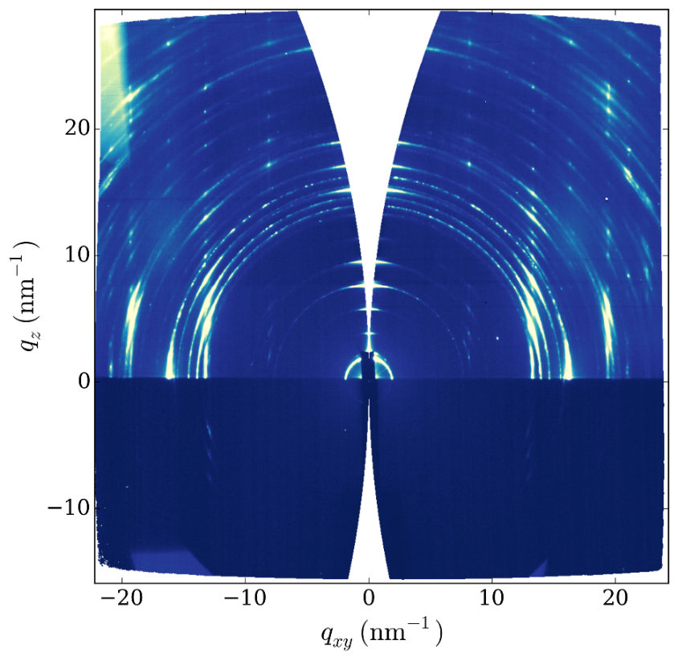
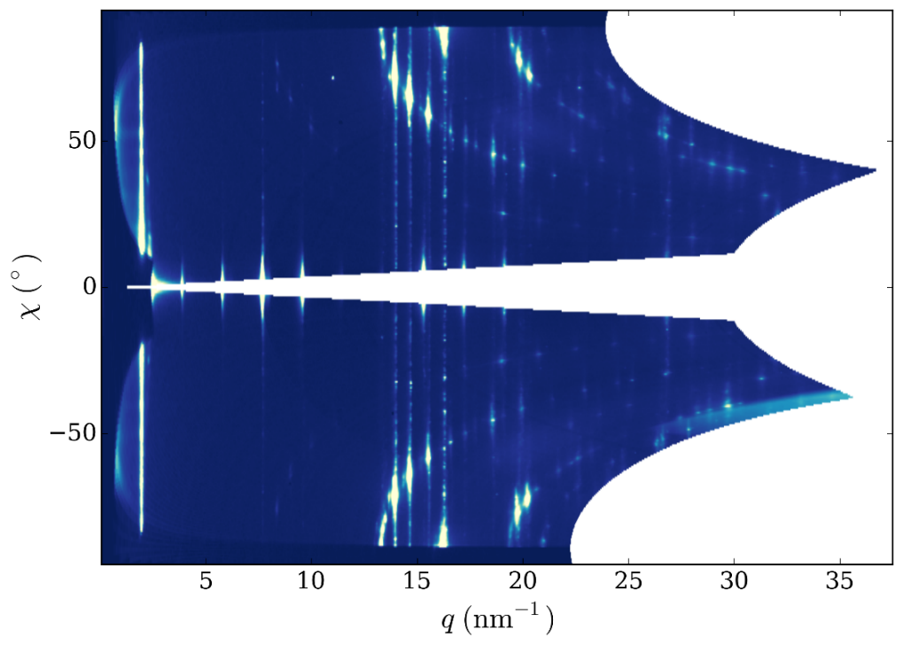
pygix: 2D projections
Raw image
Reciprocal space map
Polar projection

Slide 3
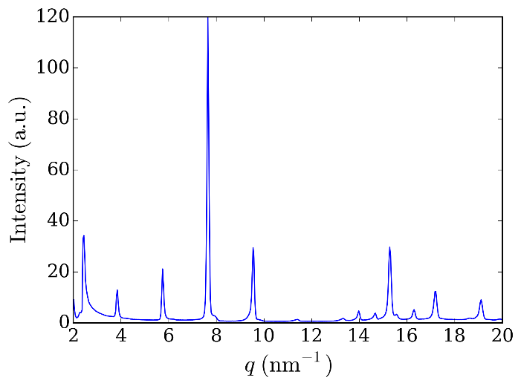
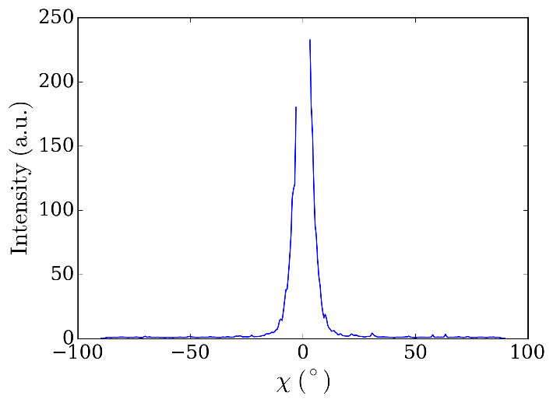
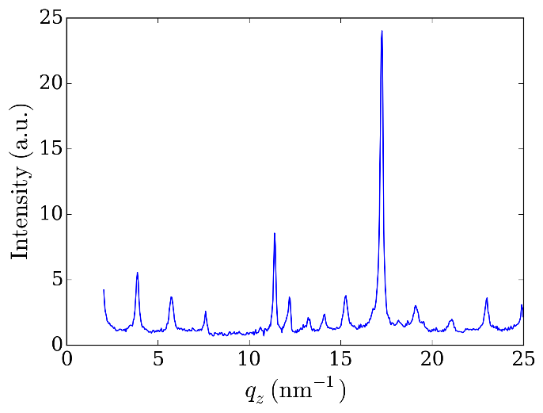
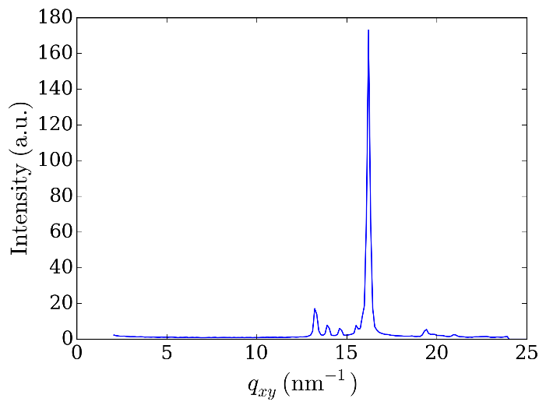
pygix: 1D reduciton
(a)
(b)
(c)
(a)
Sector
Azimuthal
(b)
(c)
(d)
(d)
Out-of-plane box
In-plane box

Slide 4
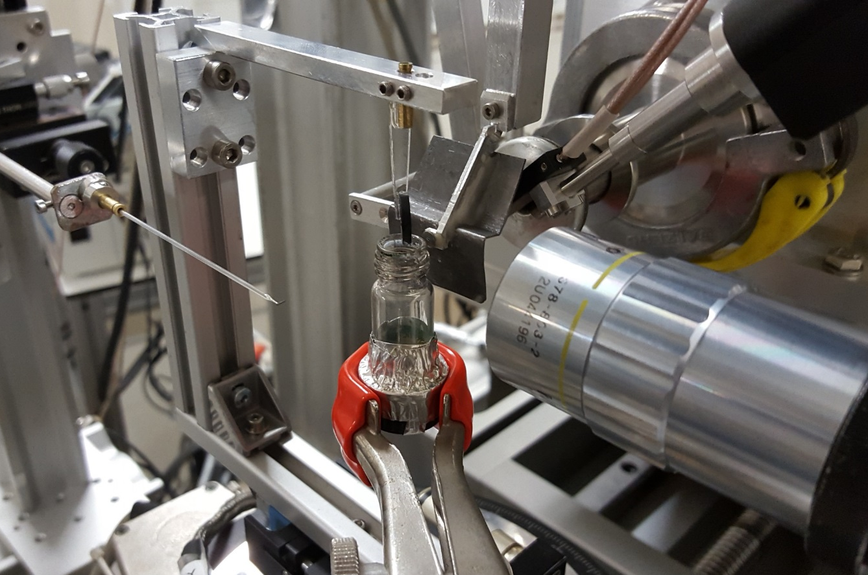
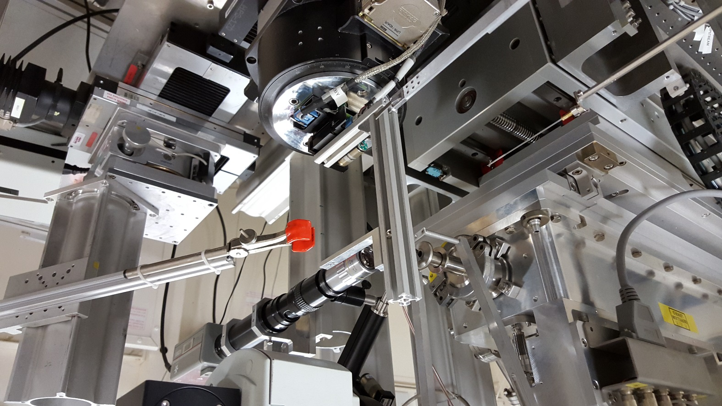
In situ dip-coating: setup on ID13 (micro)
Motorised solvent vessel
Off-axis microscope for alignment and observation
Decector: EIGER 4M

Slide 5
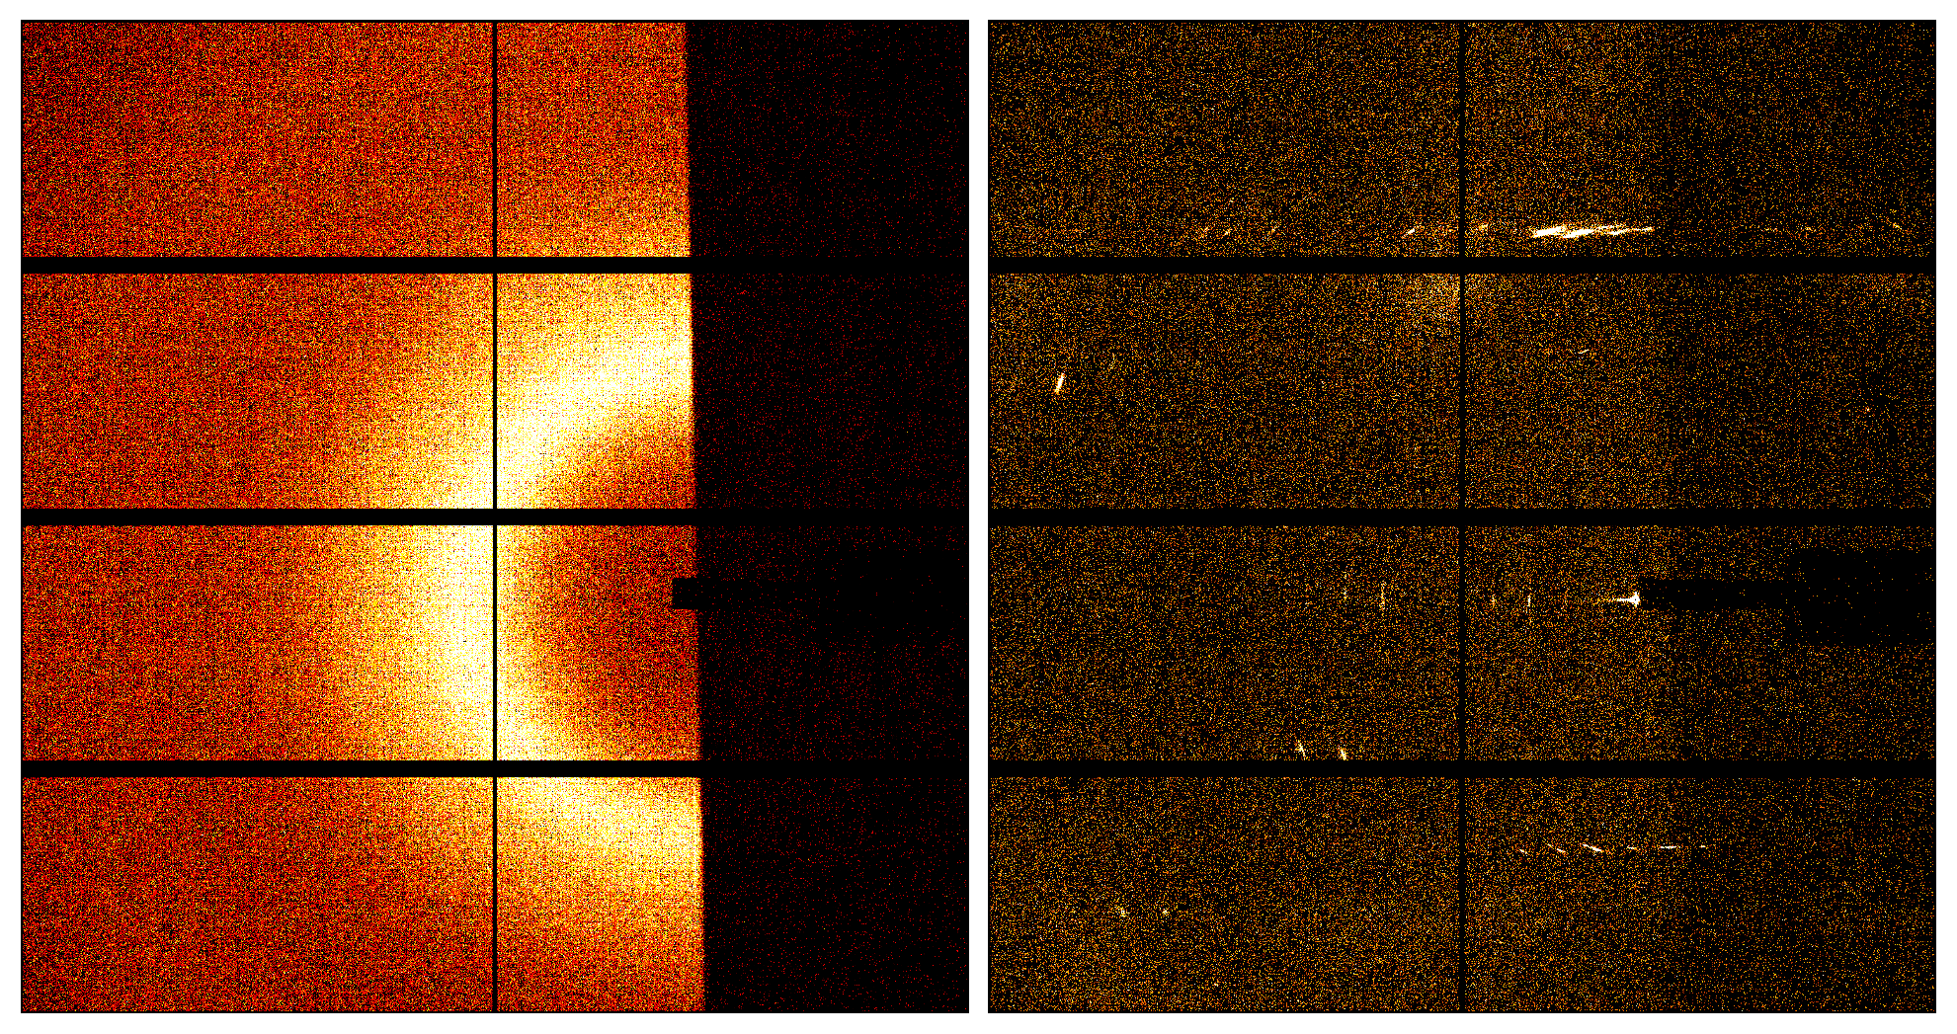
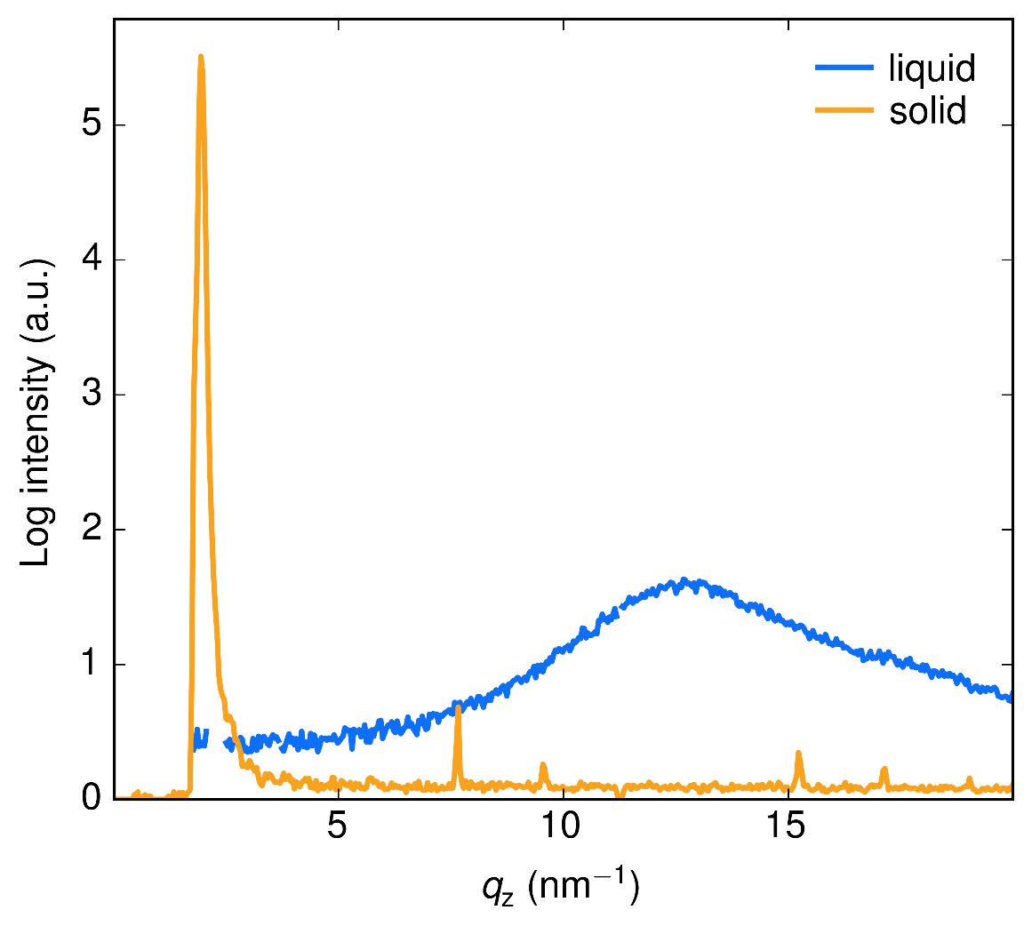
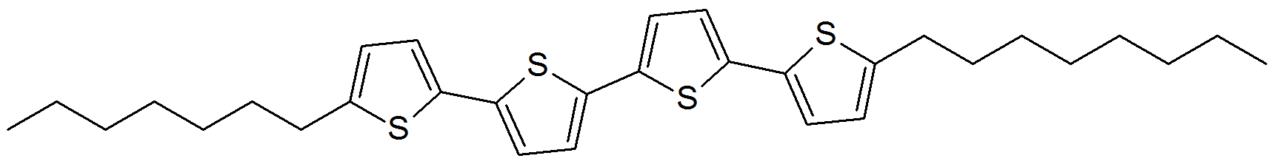
Example: organic semiconductor
liquid
solid
(100)
(400)
(500)
(800)
(900)
liquid peak
Oligothiophene solution in toluene (1 mg ml⁻¹)

Slide 6
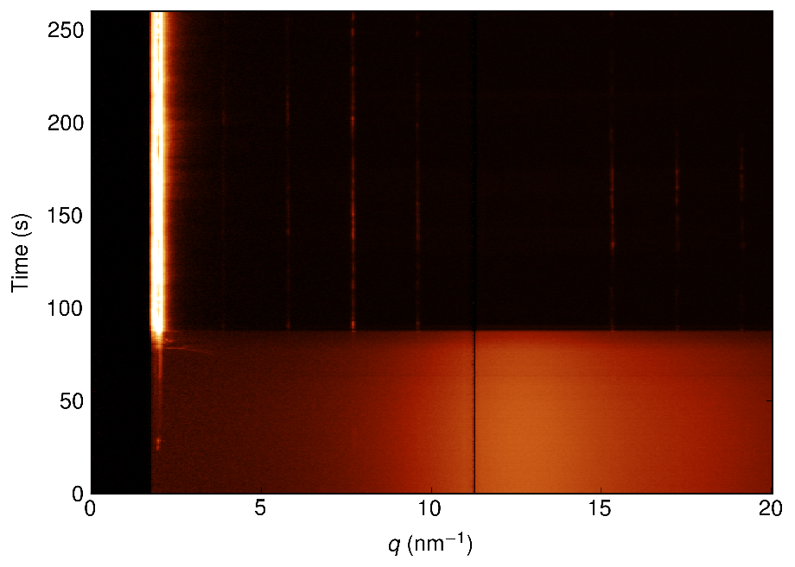
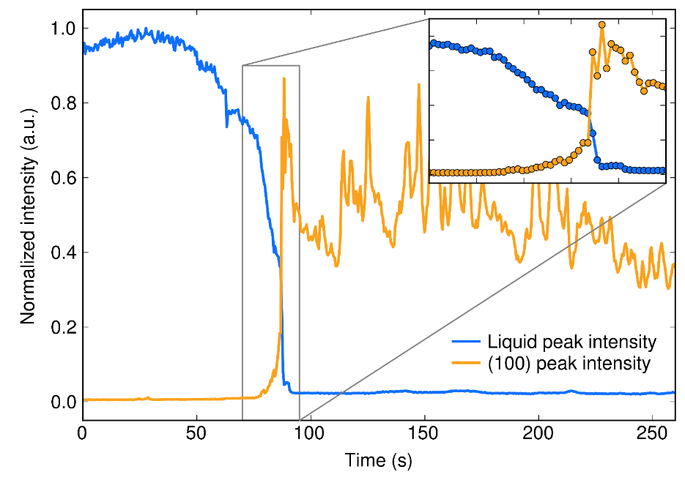
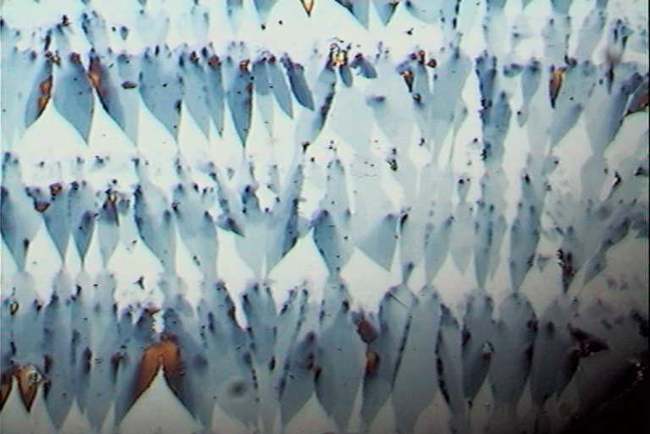
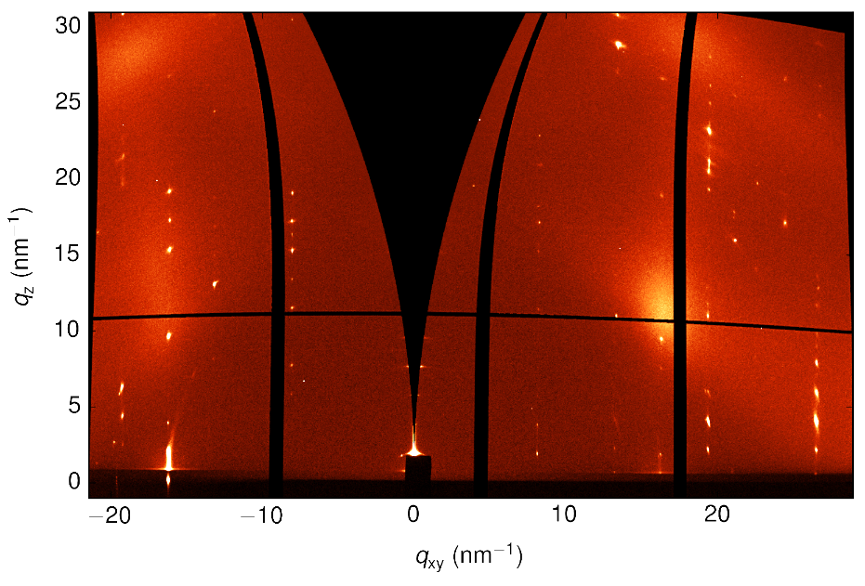
Example: organic semiconductor

